Slide 1

Validation, Learnings & Pivot to MVP2
Chirag Huria, Alana Mittleman, Rohan Paliwal, Elias El Kozah
for Digital Service Innovation

Slide 2
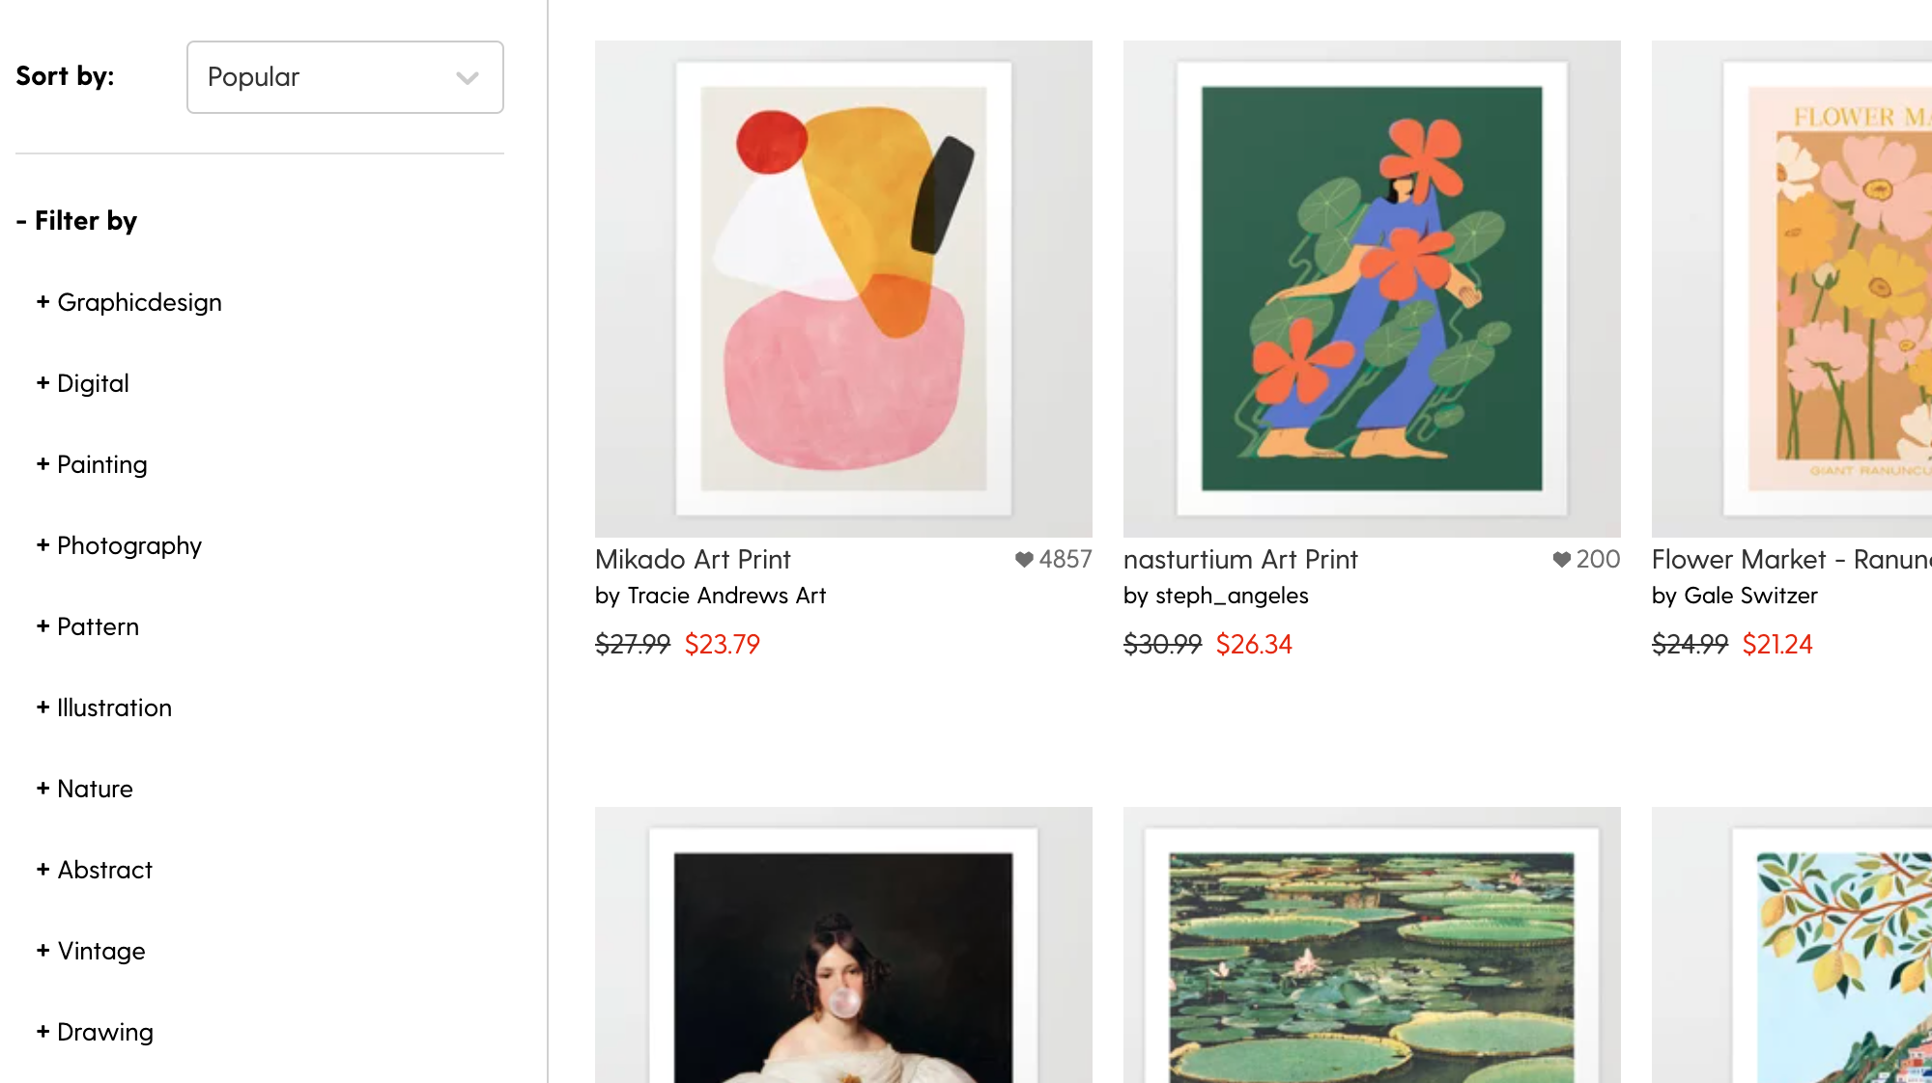
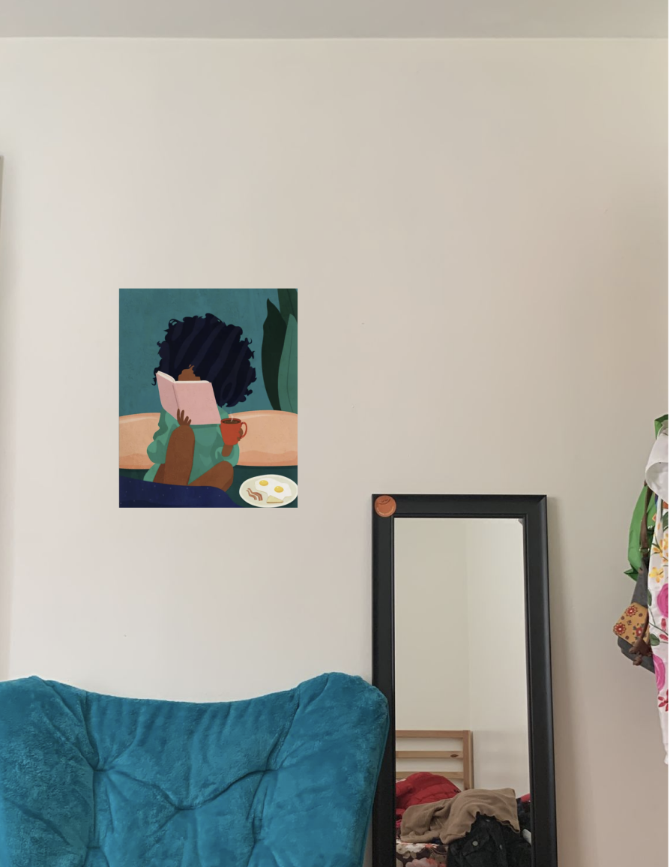

Validation
Method
We interviewed 7 members of our target audience.
We used society6 as an example of a vast gallery for users to browse.
We used think aloud protocol to observe customers browsing process, prompting them to keep talking.
We used an interactive prototype to allow users to envision art in their homes.
We used a likert scale rating to gauge whether our prototype changed their commitment to buying the art.

Slide 3
Validation
Learning Goals
What motivates people to buy art?
Does using the prototype increase people's commitment to buying art?
Does using the prototype increase people's emotional attachment to art?
What do impulsive purchases look like when buying art online?

Slide 4
Learning
1
Using the prototype made her commit to buying because it matched her furniture/upholstery
Q: What are you looking out for?
“I am thinking about if this art will go with my upholstery & furniture”
This particular user rated commitment to higher after using the prototype. She attributed this change to being able to see how well the art matched her furniture.

Slide 5
Learning
2
Using muse to view art in your own home can also convince users not to buy art
Q: Why did you decide to delete that piece?
“After seeing that painting on my wall I realized that the rest of my room is neutral and it was too colorful. ”
This user was initially drawn to a piece of art while browsing, but after using the prototype to view it in her own home she decided she didn't want it anymore.

Slide 6
Learning
3
Seeing the whole picture, size, and position helped in making the decision
Q: Did this experience influence your decision making?
“Yes, I am more confident about making this purchase”
This particular user liked the art at first but was not convinced to buy the art. The MVP helped that user see the whole picture (art on walls along with furniture), play around with the size of art and position.

Slide 7
Learning
4
Living in temporary spaces does not always make people less willing to buy art, but maybe things that are cheaper and lighter
Q: Does living in temporary spaces stop you from buying art?
“If the art is within my budget and it is easy to carry around, I would buy it ”
The user mentioned that if art is a poster it would be cheap and they would be more likely to buy it even though they are living in a temporary setup.

Slide 8
Learning
5
Seeing art in their space can convince users to buy more pieces than originally planned
“I’m going to duplicate this piece to see if it looks better as part of a set”
After seeing how the dimensions of a piece of art compared to a space on her wall, this user saw that the space would be filled better if she bought three and wanted them to all be from the same artist.

Slide 9
Learning
6
MVP 1 succeeded in preventing ‘failed purchases’
Where a failed purchase is when a user buys a painting and later discovers that it doesn’t look good in their home or they have nowhere to put it.

Slide 10
Pivot to MVP 2
Recommend similar art
In MVP 1, we addressed the problem identified that spontaneous art purchases fail in the sense that customers find they don’t have appropriate wall space.
By creating a way for muse to recommend art, we can offer continued support to customers who after viewing art in their room using muse find that they no longer want the piece. Muse can find them a replacement.

